Slide 1

Humanware/CTAG: Because We Care
Cleveland Metropolitan School District

Slide 2
Targeted Student Support
Closing the Achievement Gap (CTAG)
    CTAG is a targeted intervention
    Male students of color
    Rising 9th graders
    At risk of dropping out of high school

Slide 3
RISK FACTORS
Failed 2 or more 8th grade core courses
Absent 20% or more
5 or more days suspension
Over age for grade level

Slide 4
Key components
Linkage Coordinators
Individual/Group Advisement
Class Meetings
Summer Bridge
Exposure Trips

Slide 5
LINKAGE COORDINATOR
Serve as productive role model
Strengthen goal setting & time management
Develop constructive decision making
Improve attendance
Enhance social emotional skill set
Advocate for the students

Slide 6
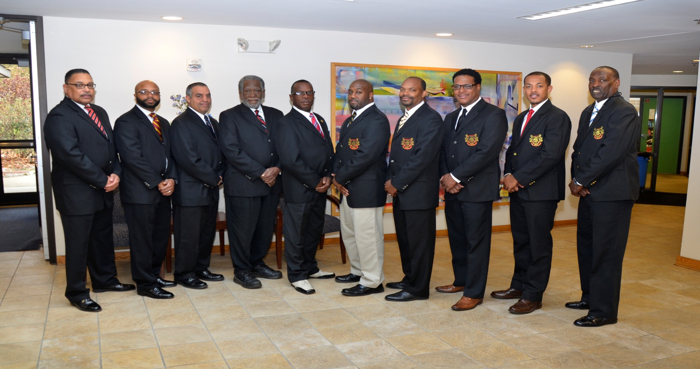
LINKAGE COORDINATORS

Slide 7
EXPOSURE experiences
City Club Youth Luncheon
College Tours/Fairs
Service Projects
Holiday Book Club
Overnight Lock-In
Spring Break Adventure

Slide 8
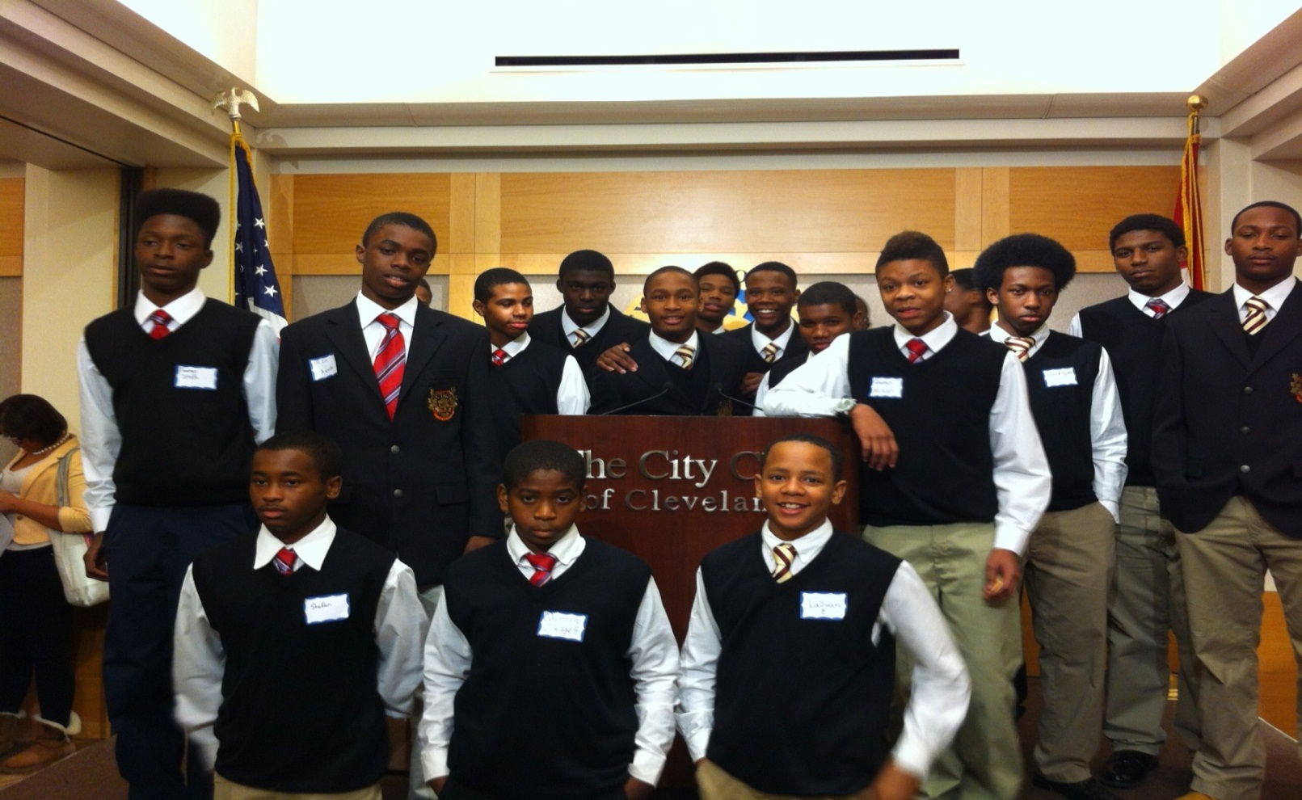
Cleveland City Club luncheon

Slide 9
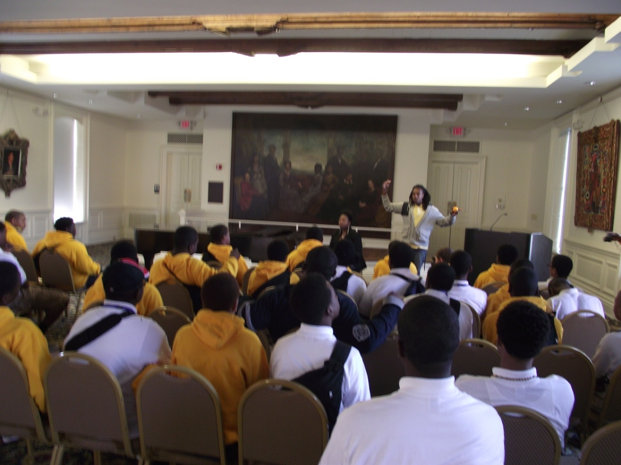
CTAG @ Fisk University

Slide 10
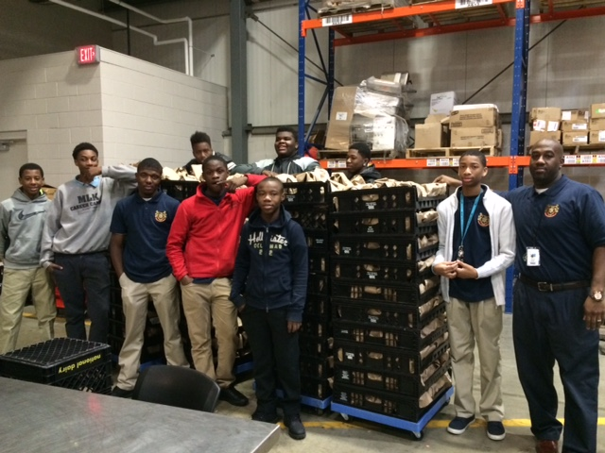
CTAG @ CLEVELAND FOOD BANK

Slide 11
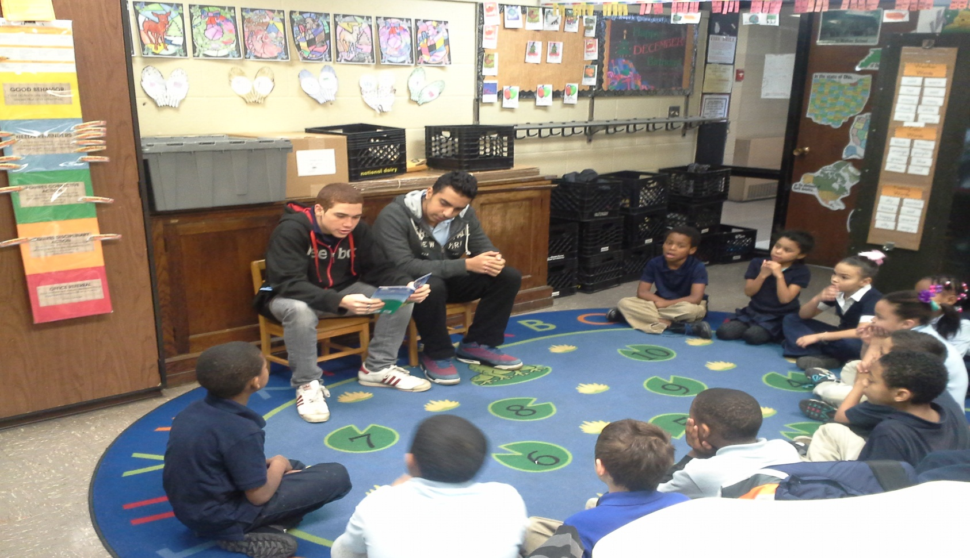
HOLIDAY BOOK CLUB

Slide 12
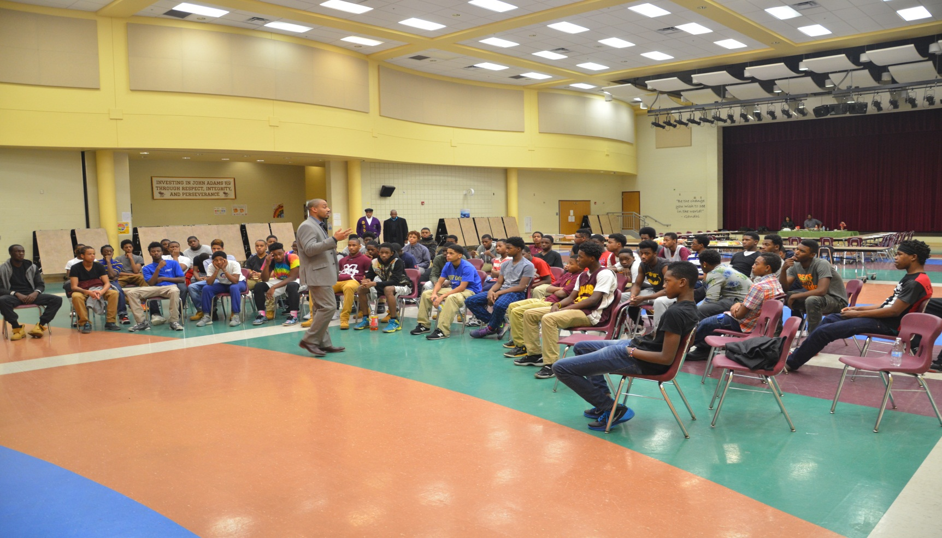
OVERNIGHT LOCK-IN

Slide 13
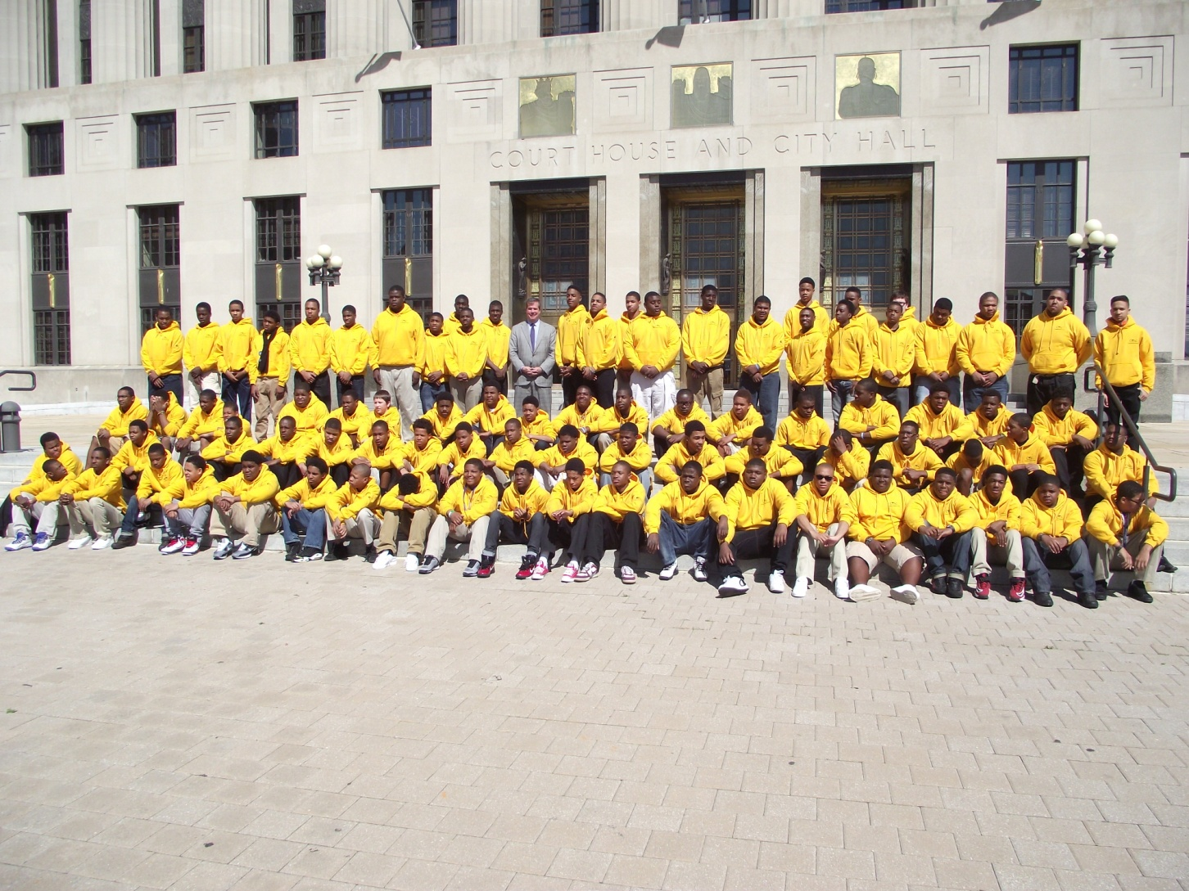
Spring Break - Nashville

Slide 14
SUMMER BRIDGE
Leadership training
Life skills development
High School transitioning
Robotics
Exposure experiences
Transportation, breakfast & lunch

Slide 15
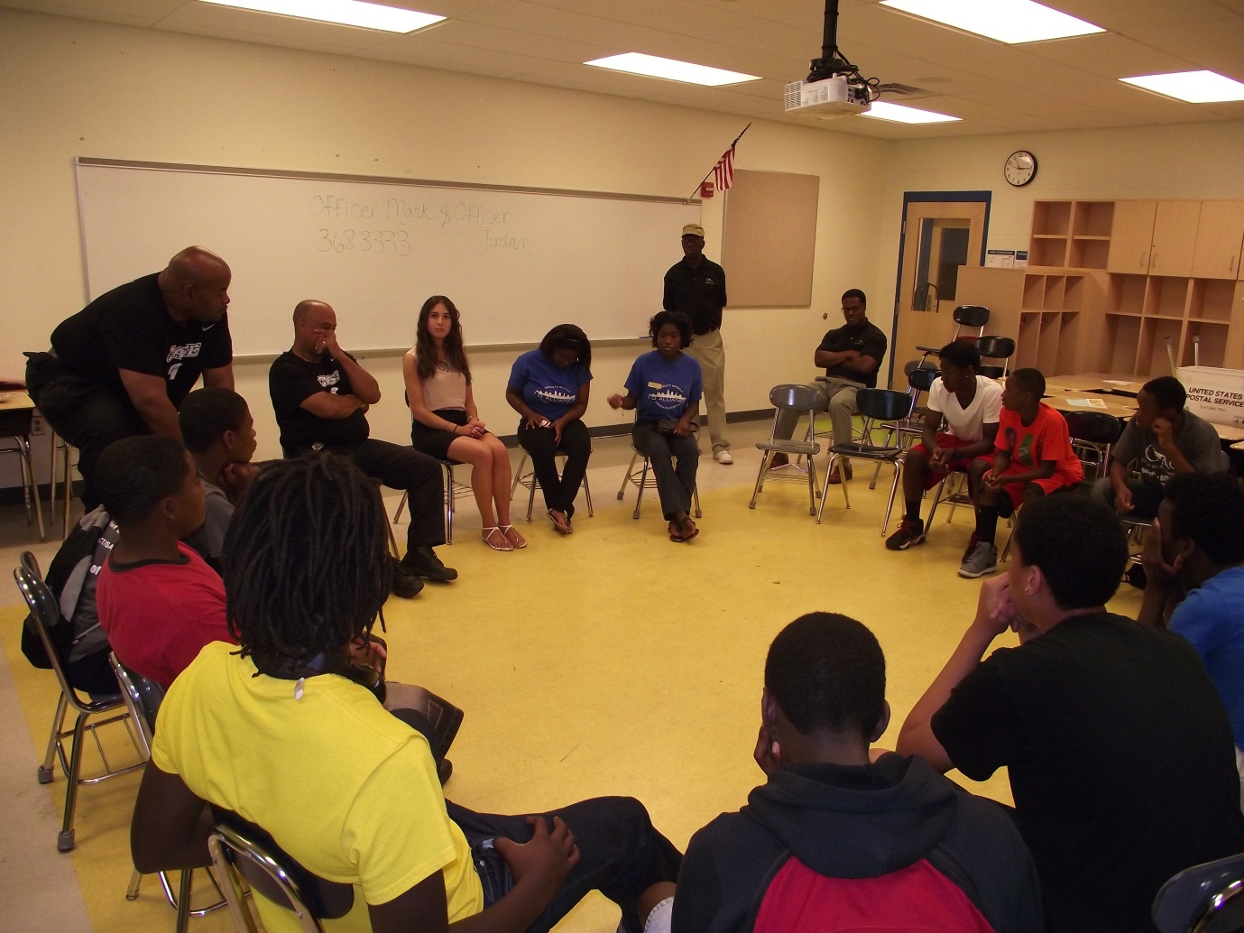
Leadership training
(CONFLICT RESOLUTION)

Slide 16
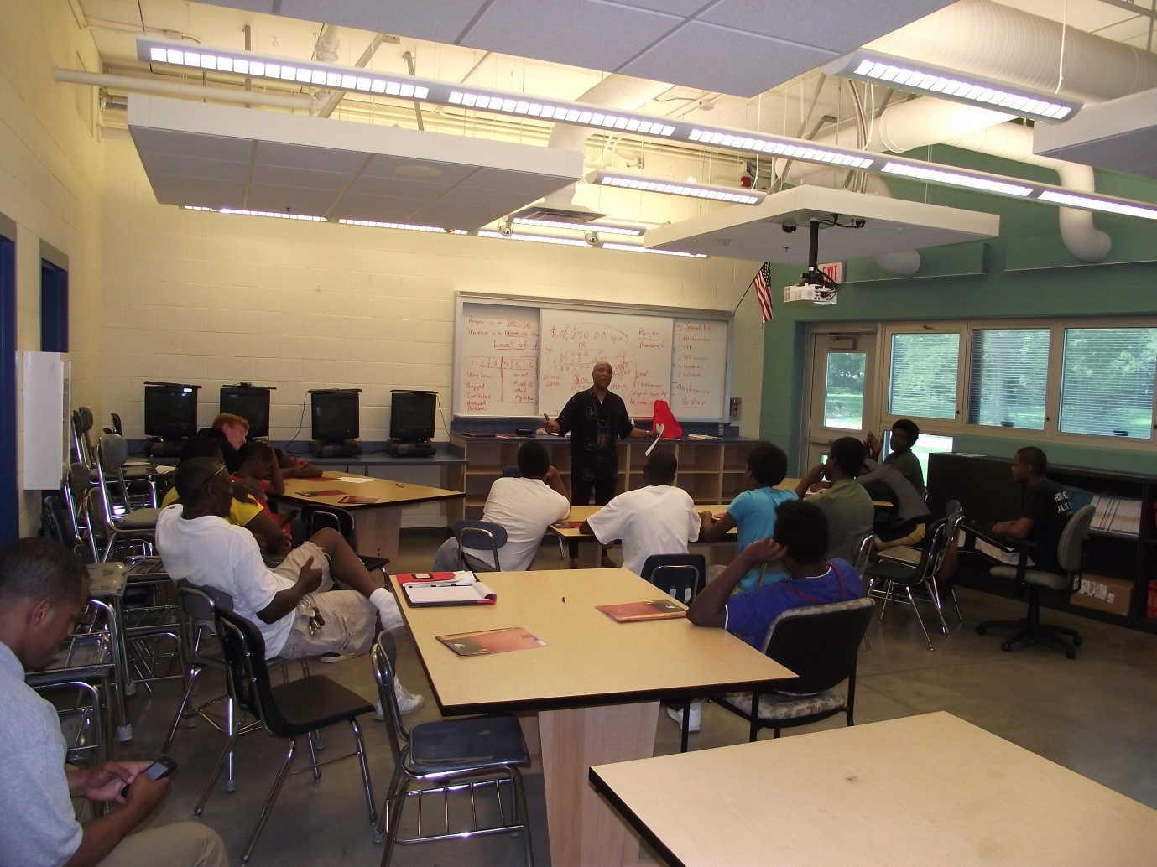
LIFE SKILLS
(FATHERHOOD INITIATIVE)

Slide 17
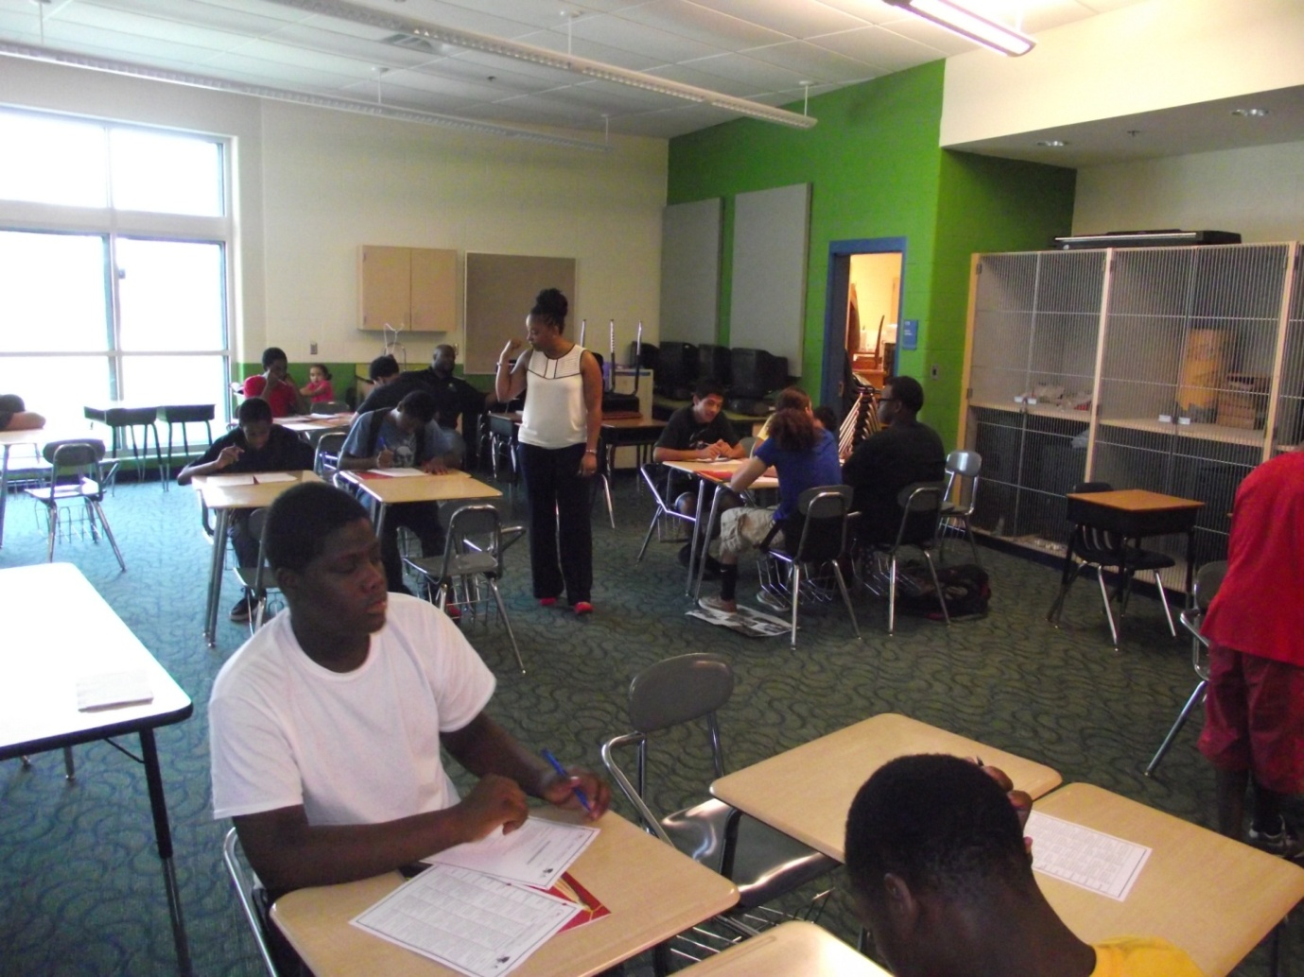
High school transition
(learning Styles)

Slide 18
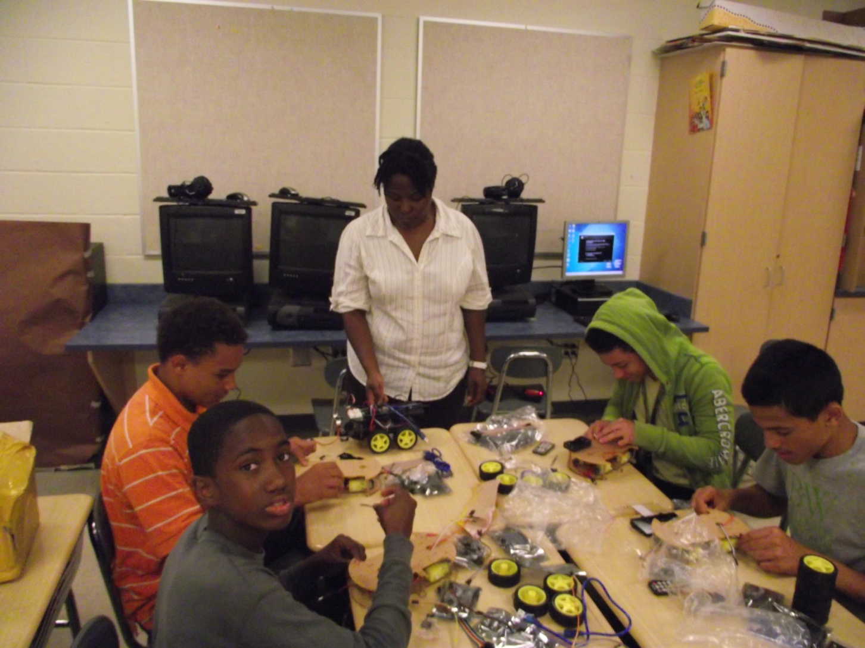
Robotics
(postsecondary partnership)

Slide 19
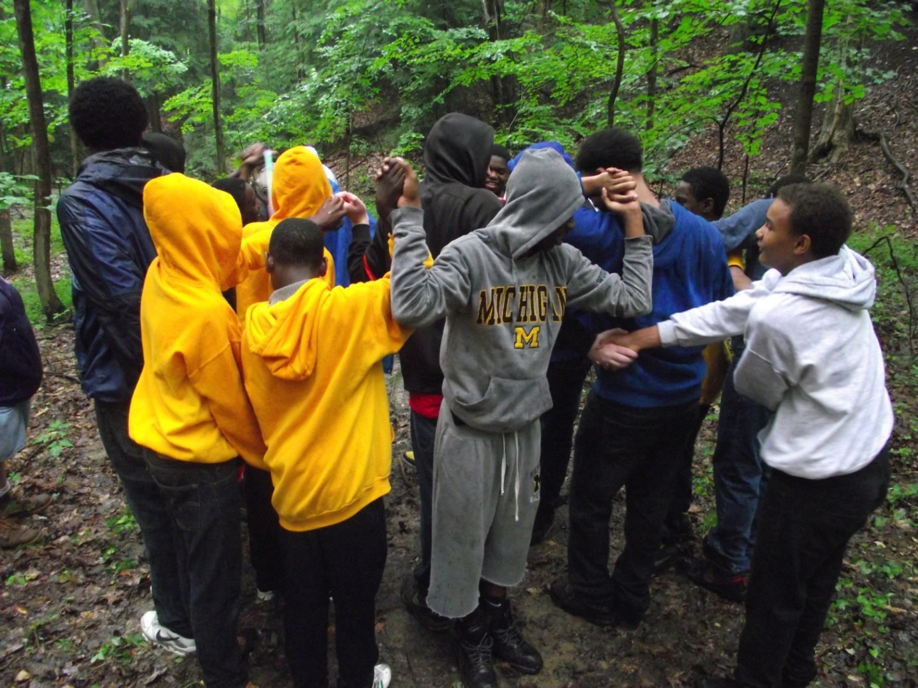
Exposure experience
(Team Building)

Slide 20
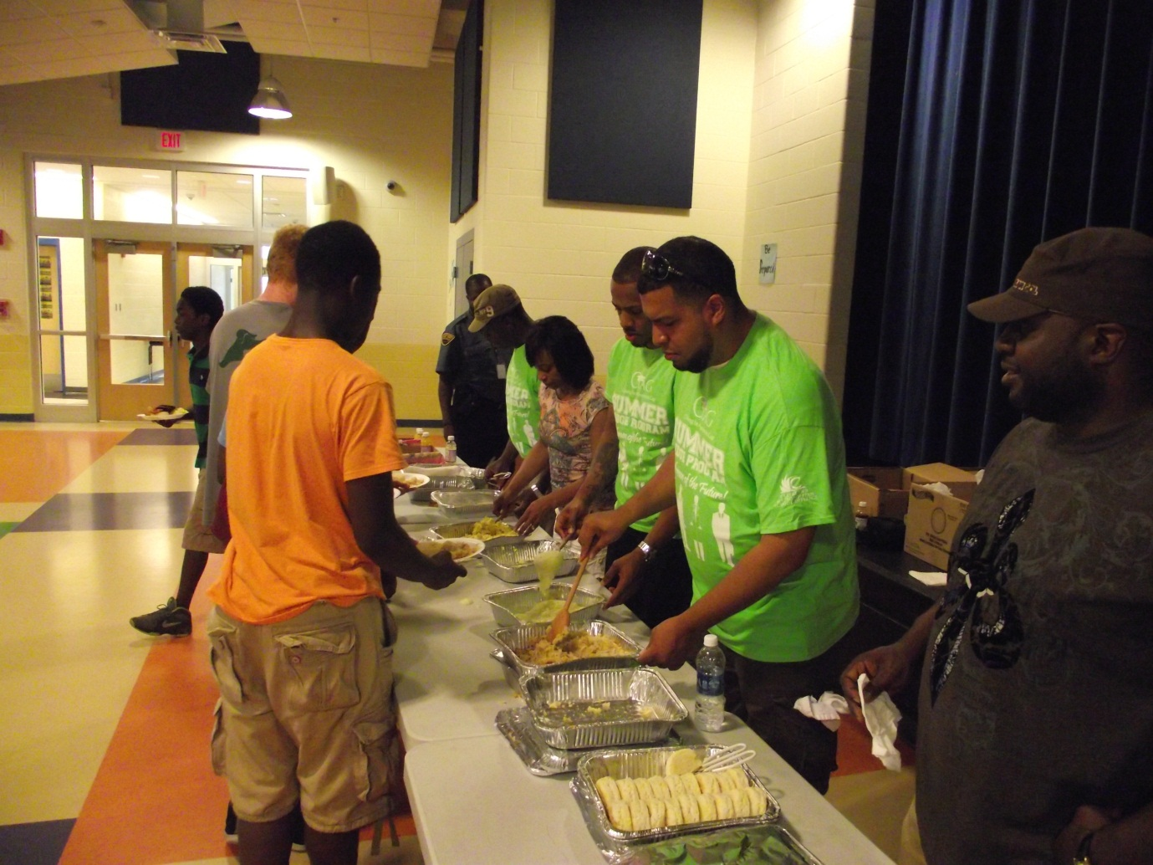
Transportation, breakfast & lunch

